Slide 1

PulseNet – AI Medical Diagnosis Assistant
PRAVEEN KUMAR V
NITHIN R
SANJANA KUMARI S

Slide 2
PROBLEM STATEMENT
Slide 2: Problem Statement
This project builds a GenAI-powered medical diagnosis assistant for rural health centers and primary clinics in India. It helps doctors and health workers quickly understand patient problems by analyzing symptoms, past medical history, and basic vital signs. The system gives possible diseases with confidence scores, suggests basic treatment steps, warns about drug interactions, and clearly tells when a specialist referral is needed. It supports Indian languages like Hindi, Tamil, Telugu, and Bengali, and explains results in simple words for both doctors and patients. The platform works even with low internet, follows Indian healthcare guidelines, protects patient privacy, and continuously learns from common rural health cases to improve over time.

Slide 3
OUR SOLUTION
AI-based diagnosis assistant that helps frontline health workers make informed decisions.
Accepts symptom input in multiple Indian languages (Hindi, Tamil, Telugu, Bengali) for wider accessibility.
Generates differential diagnoses with confidence scores to guide next steps.
Provides treatment guidance and drug dosage recommendations based on patient demographics.
Issues referral alerts for cases that require specialist attention or emergency care.
Simple, user-friendly UI designed for low-literacy and low-connectivity environments.
Shows results in easy-to-understand language for both health workers and patients.

Slide 4
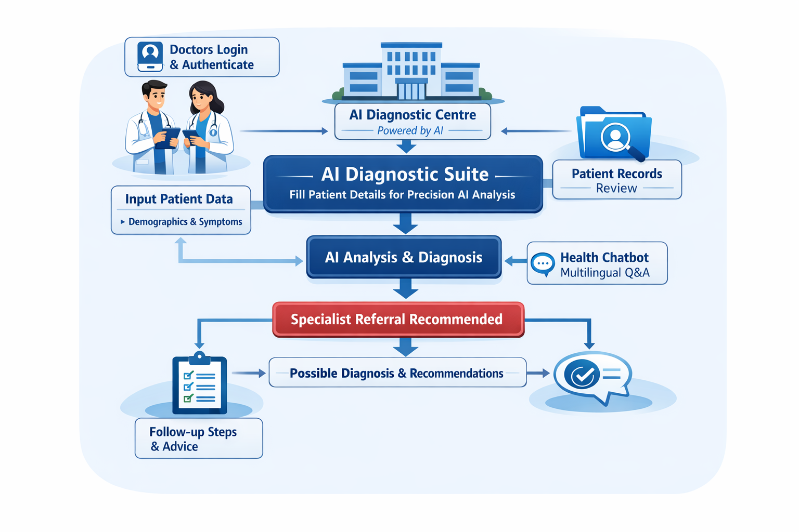
SYSTEM ARCHITECTURE

Slide 5
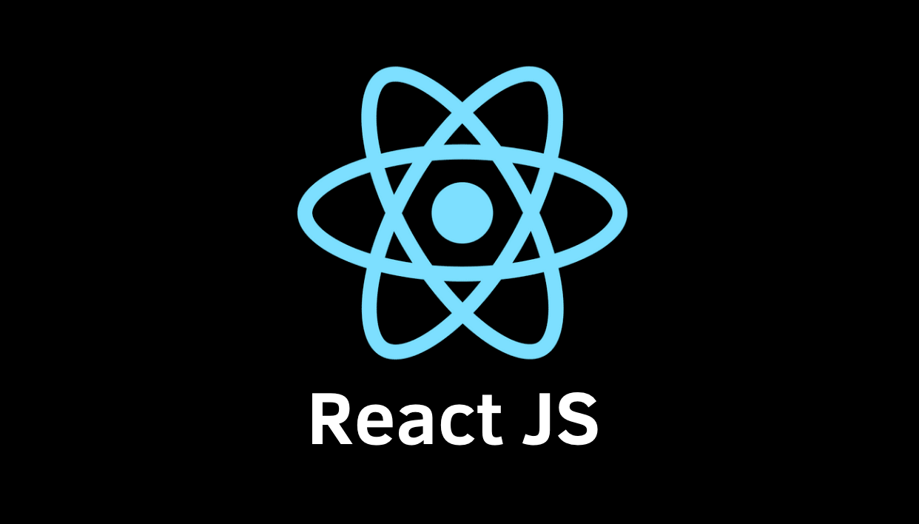
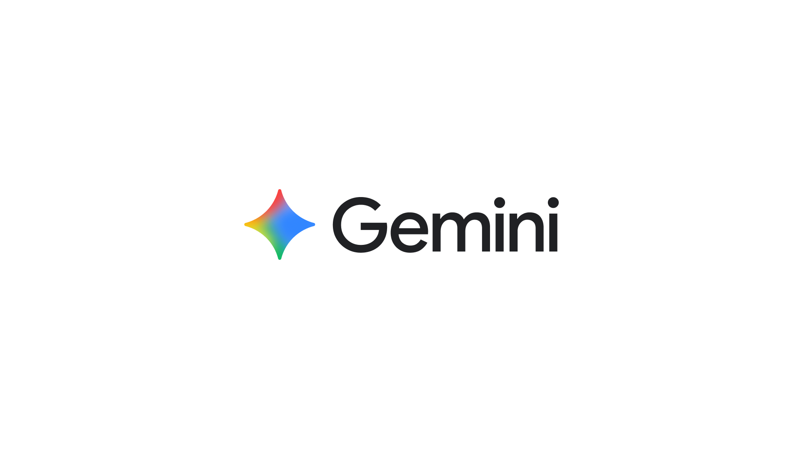
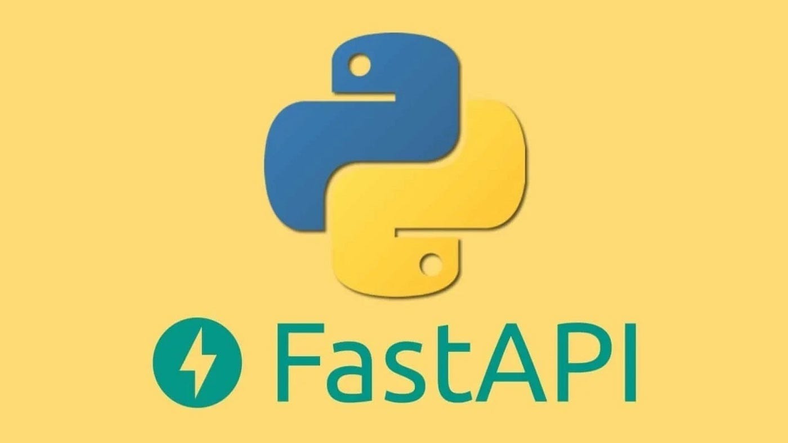

TECH STACK

Slide 6
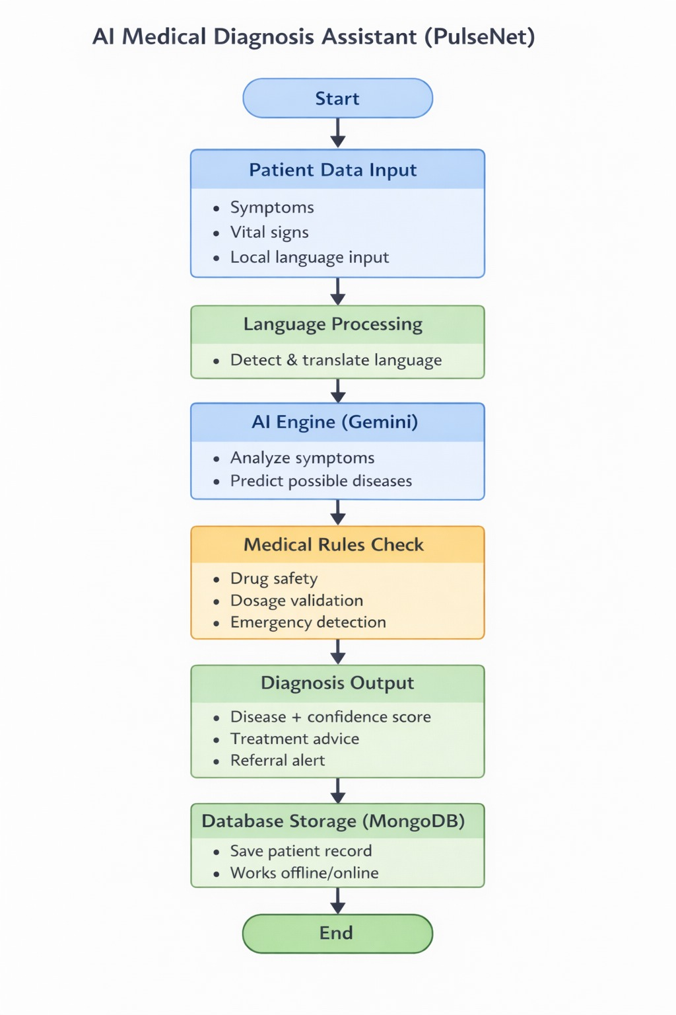
PROPOSED METHODOLOGY

Slide 7
MODULAR DESCRIPTION
1️⃣ Symptom Analysis Module
The Symptom Analysis Module is the core entry point of the PulseNet system. It enables healthcare workers in rural clinics to input patient information easily and accurately, even in low-resource environments.
Allows entry of patient symptoms, basic vital signs (temperature, blood pressure, pulse rate), and medical history.
Supports multilingual input in Indian languages such as Hindi, Tamil, Telugu, and Bengali to overcome language barriers.
Uses language detection and translation techniques to convert local language inputs into a standard medical format.
Processes structured and unstructured symptom data for better understanding.
Integrates with the AI diagnosis engine (Gemini) to identify possible diseases.
Generates multiple possible diagnoses along with confidence scores.
Helps frontline health workers make quick and informed decisions.

Slide 8
MODULAR DESCRIPTION
2 DRUG INTERACTION MODULE
The Drug Interaction Module ensures patient safety by validating prescribed medicines and preventing harmful drug combinations.
Checks compatibility between prescribed drugs using predefined medical safety rules.
Detects potential drug–drug interactions that may cause adverse reactions.
Alerts healthcare workers about unsafe or conflicting medications.
Ensures that medications follow standard treatment protocols.
Helps avoid medication errors commonly caused by lack of expert supervision.
Enhances treatment accuracy and reduces health risks.
Operates fully offline using locally stored interaction rules.
Improves trust and reliability of AI-assisted treatment recommendations.

Slide 9
MODULAR DESCRIPTION
3 Dosage Recommendation Module (Demographic-based)
The Dosage Recommendation Module personalizes treatment by calculating safe and effective medication dosages based on patient demographics.
Recommends drug dosage based on age, weight, gender, and medical condition.
Adjusts dosage for children, adults, and elderly patients.
Prevents over-dosage and under-dosage through rule-based validation.
Follows standard clinical dosage guidelines used in primary healthcare.
Supports healthcare workers with limited pharmacological knowledge.
Enhances patient safety and treatment effectiveness.

Slide 10
DEPLOYMENT -VERCEL
https://pulsenetai.vercel.app/

Slide 11
CONCLUSION
PulseNet provides an AI-powered medical diagnosis assistant tailored for rural healthcare.
Supports multilingual input and delivers easy-to-understand diagnosis for both patients and healthcare workers.
Combines Gemini AI with rule-based safety checks to ensure accurate, safe, and explainable results.
Provides personalized treatment guidance, drug interaction alerts, and demographic-based dosage recommendations.
Enhances rural healthcare efficiency, reduces dependency on specialists, and improves patient outcomes.
Modular architecture ensures scalability and future enhancements, like voice input and wearable device integration.

